Slide 1



Yusr
Pitch Deck
IT427 - Entrepreneurship and Innovation in IT
_____________________________
Supervised By: Dr.Nora Alhammad

Slide 2

Outline
01
The problem
02
Solution
03
Customer Segments
05
Competitive Landscape
03
06
Revenue Model
Market Size
07
08
Marketing Campaign
Financial Projection
09
10
Our Ask
The Team

Slide 3




The Problem
Millions of Pilgrims Struggle Every Year
1300+
77.4%
71%
Deaths from heat
Loses tawaf count
Feared losing
in Hajj 2024
in crowd
family

Slide 4
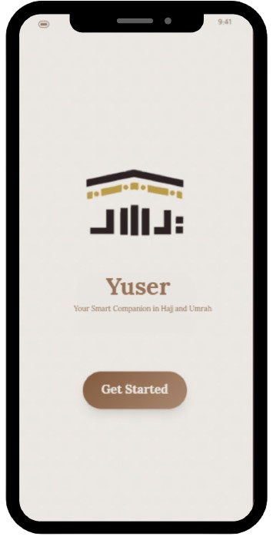
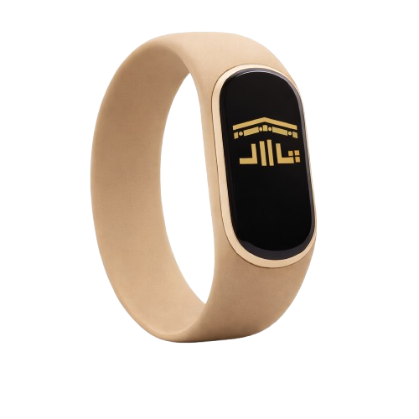

Solution
One Wristband, Complete Peace of Mind
Bracelet
Mobile Application

Slide 5




Customer Segments
Who We Serve
B2C
Elderly & High-Risk
Family Groups
International Pilagrism
First-time Pilagrims

Slide 6





Competitive Landscape
The only Wearable Solution
High ease of performing rituals
Low safety & peace of mind
High safety & peace of mind
Low ease of performing rituals

Slide 7

Market Size
Yusr’s Market Share
Hajj & Umrah market size × Unit price (purchase + rental mix)
TAM
5,169,929,675
SAM
TAM × Wearable health adoption rate
3,593,101,124
SOM
SAM / (Competitors + Yusr)
598,850,187

Slide 8
Revenue Model
Two Revenue Streams
Direct Purchase
Short-Term Rental
267 SAR
40 SAR
per day
57.3% prefer rental
42.7% prefer purchase

Slide 9
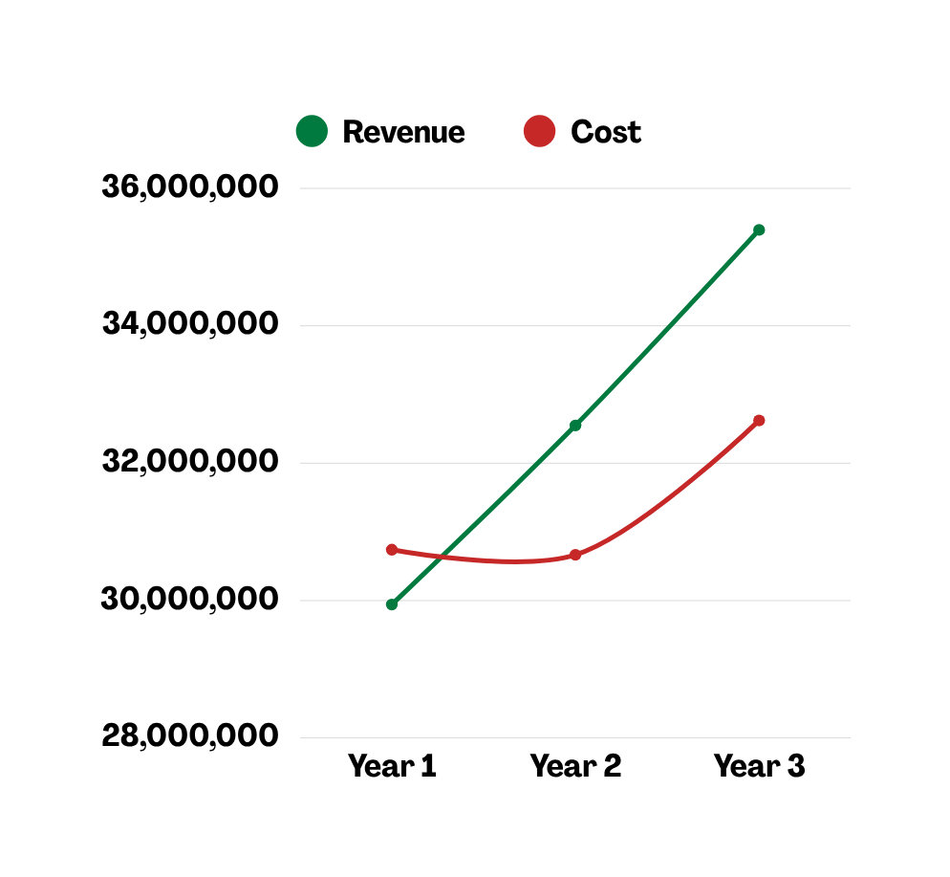
Financial Projection
Profitable by Year 2
Year 1
798K SAR
Startup investment year
Year 2
1.88M SAR
Break-even achieved
Year 3
2.77 SAR
+47.2% profit growth

Slide 10






The Team
Yusr Team Members
Fajer Mohammed Alamro
Walaa Saif Alislam Mohammed
Operations & Finance Manager
CEO
Aljawharah Ahmed Alsubaie
Rama Khalid Alomair
Director of UX
AI Specialist
Rima Khalid Alsonbul
Remas Hezam Alsubaie
Hardware Engineer
Marketing Specialist

Slide 11

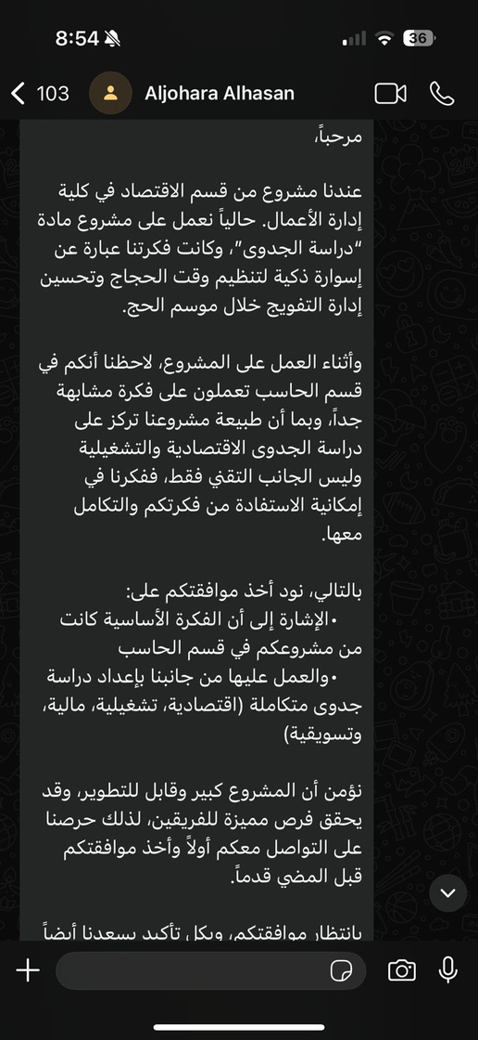
Marketing Campaign
Early Traction
And beyond the numbers — our campaign generated an inbound collaboration request

Slide 12


Our Ask
Join Us in Making Pilgramige Safer for Every Muslim
Seeking 8M SAR Seed Funding
28,3% equity
29.9M SAR Valuation

Slide 13
Any Questions?
Thank You For Listening

